Slide 2
In the Beginning….

Slide 3
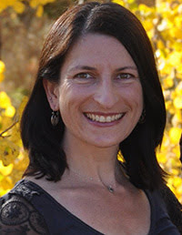
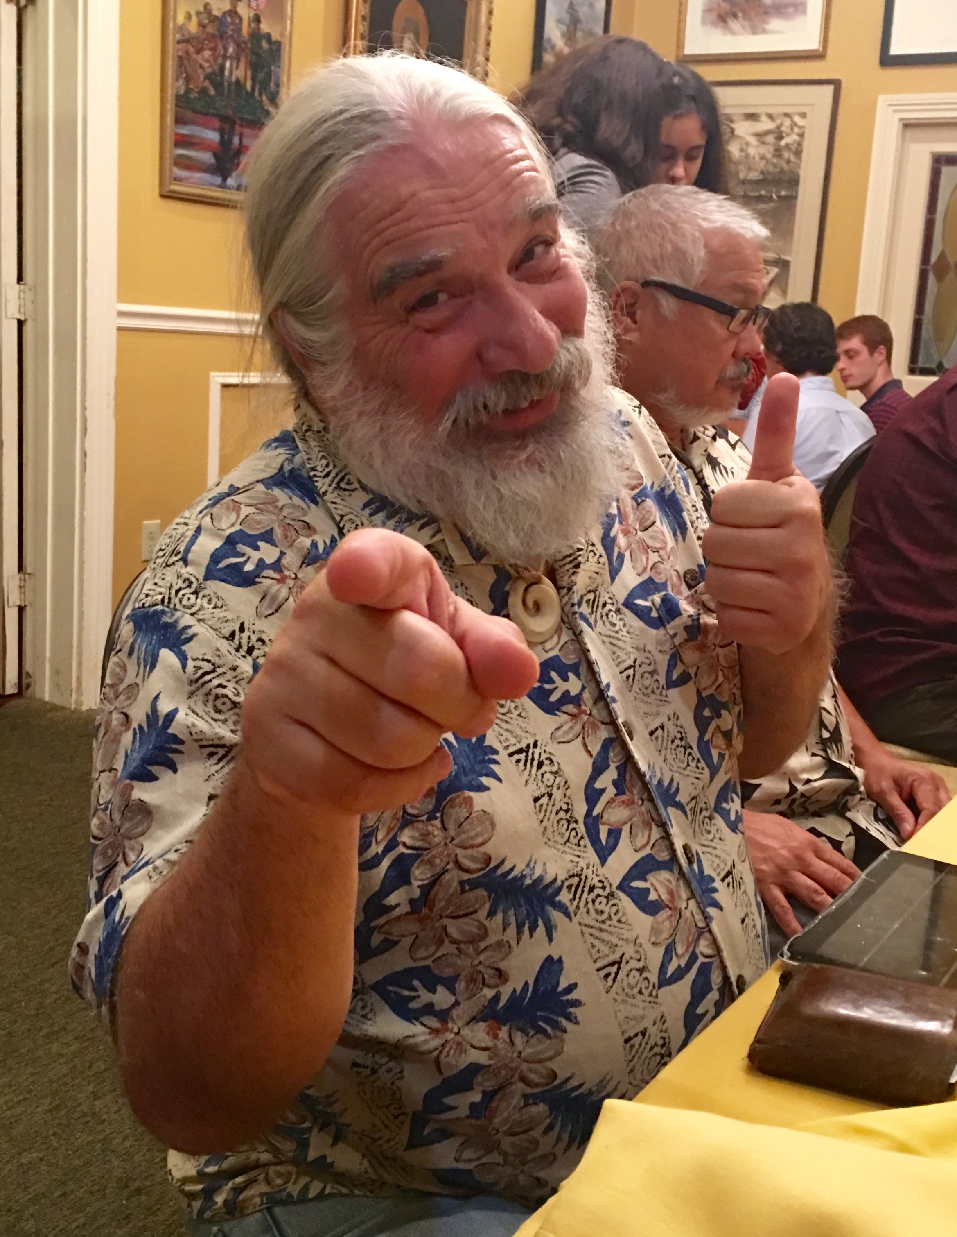
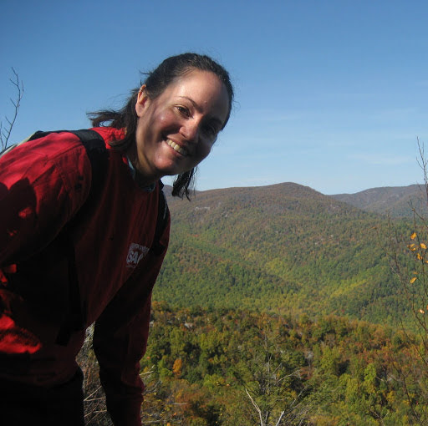
Fortunately, there was….

Slide 4
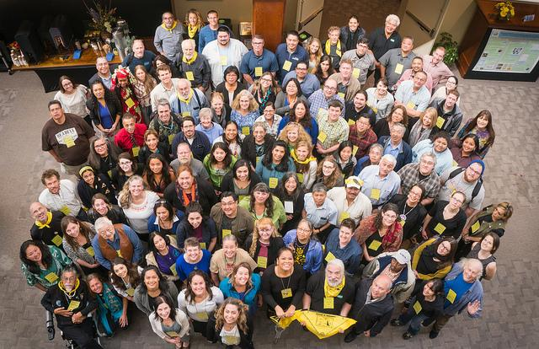
The (R)Evolution
Started out as….
Bringing social and physical scientists and
engineers together with Native American community members
Evolved into….
a movement of engaged tribal and community leaders, scientific professionals, environmental and communication experts, students, educators, and artists from across the United States, including Alaska, Hawai‘i, and the Pacific Islands, and around the world

Slide 5
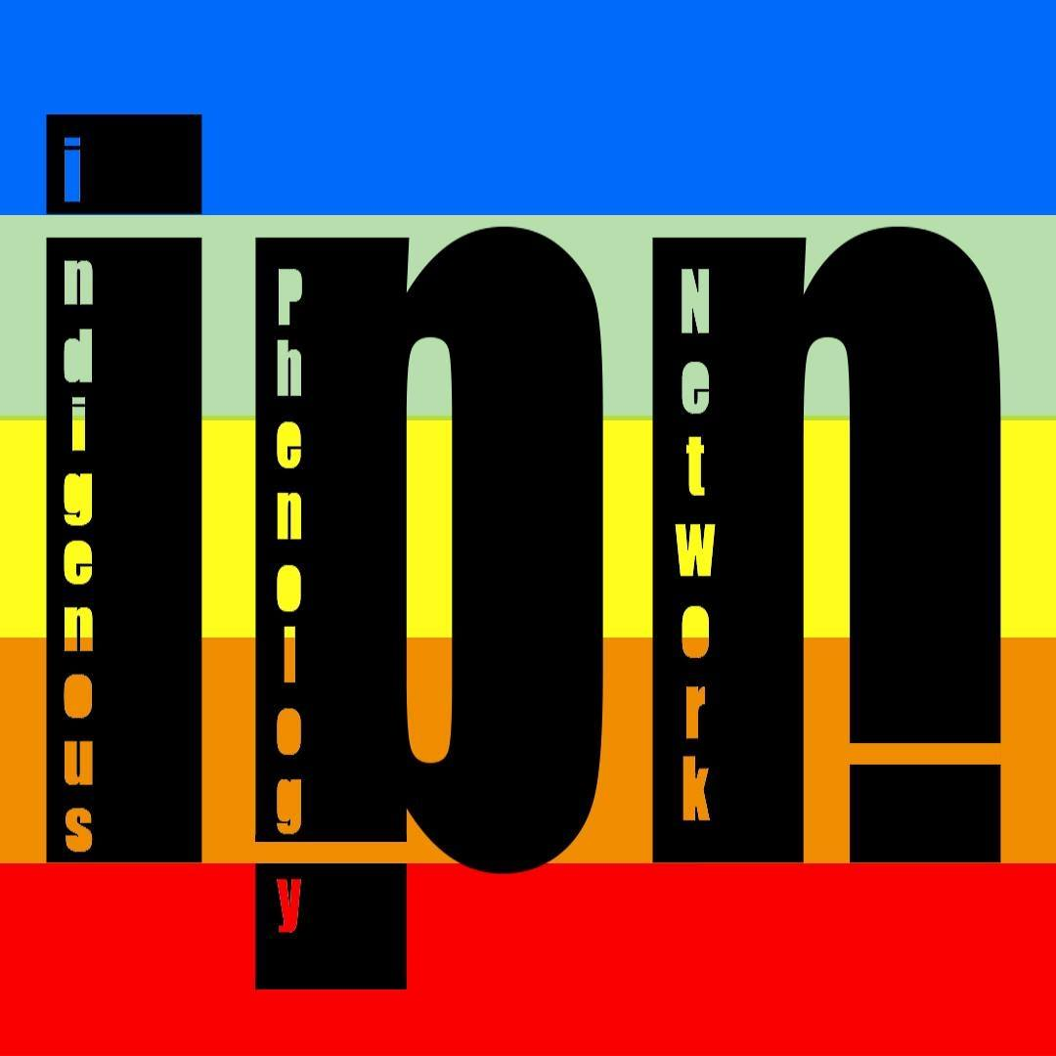
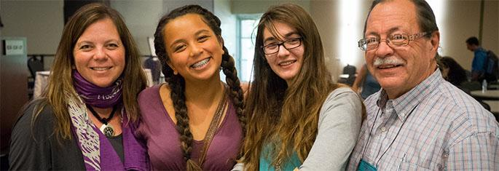
Highlighted Outcomes

Slide 6
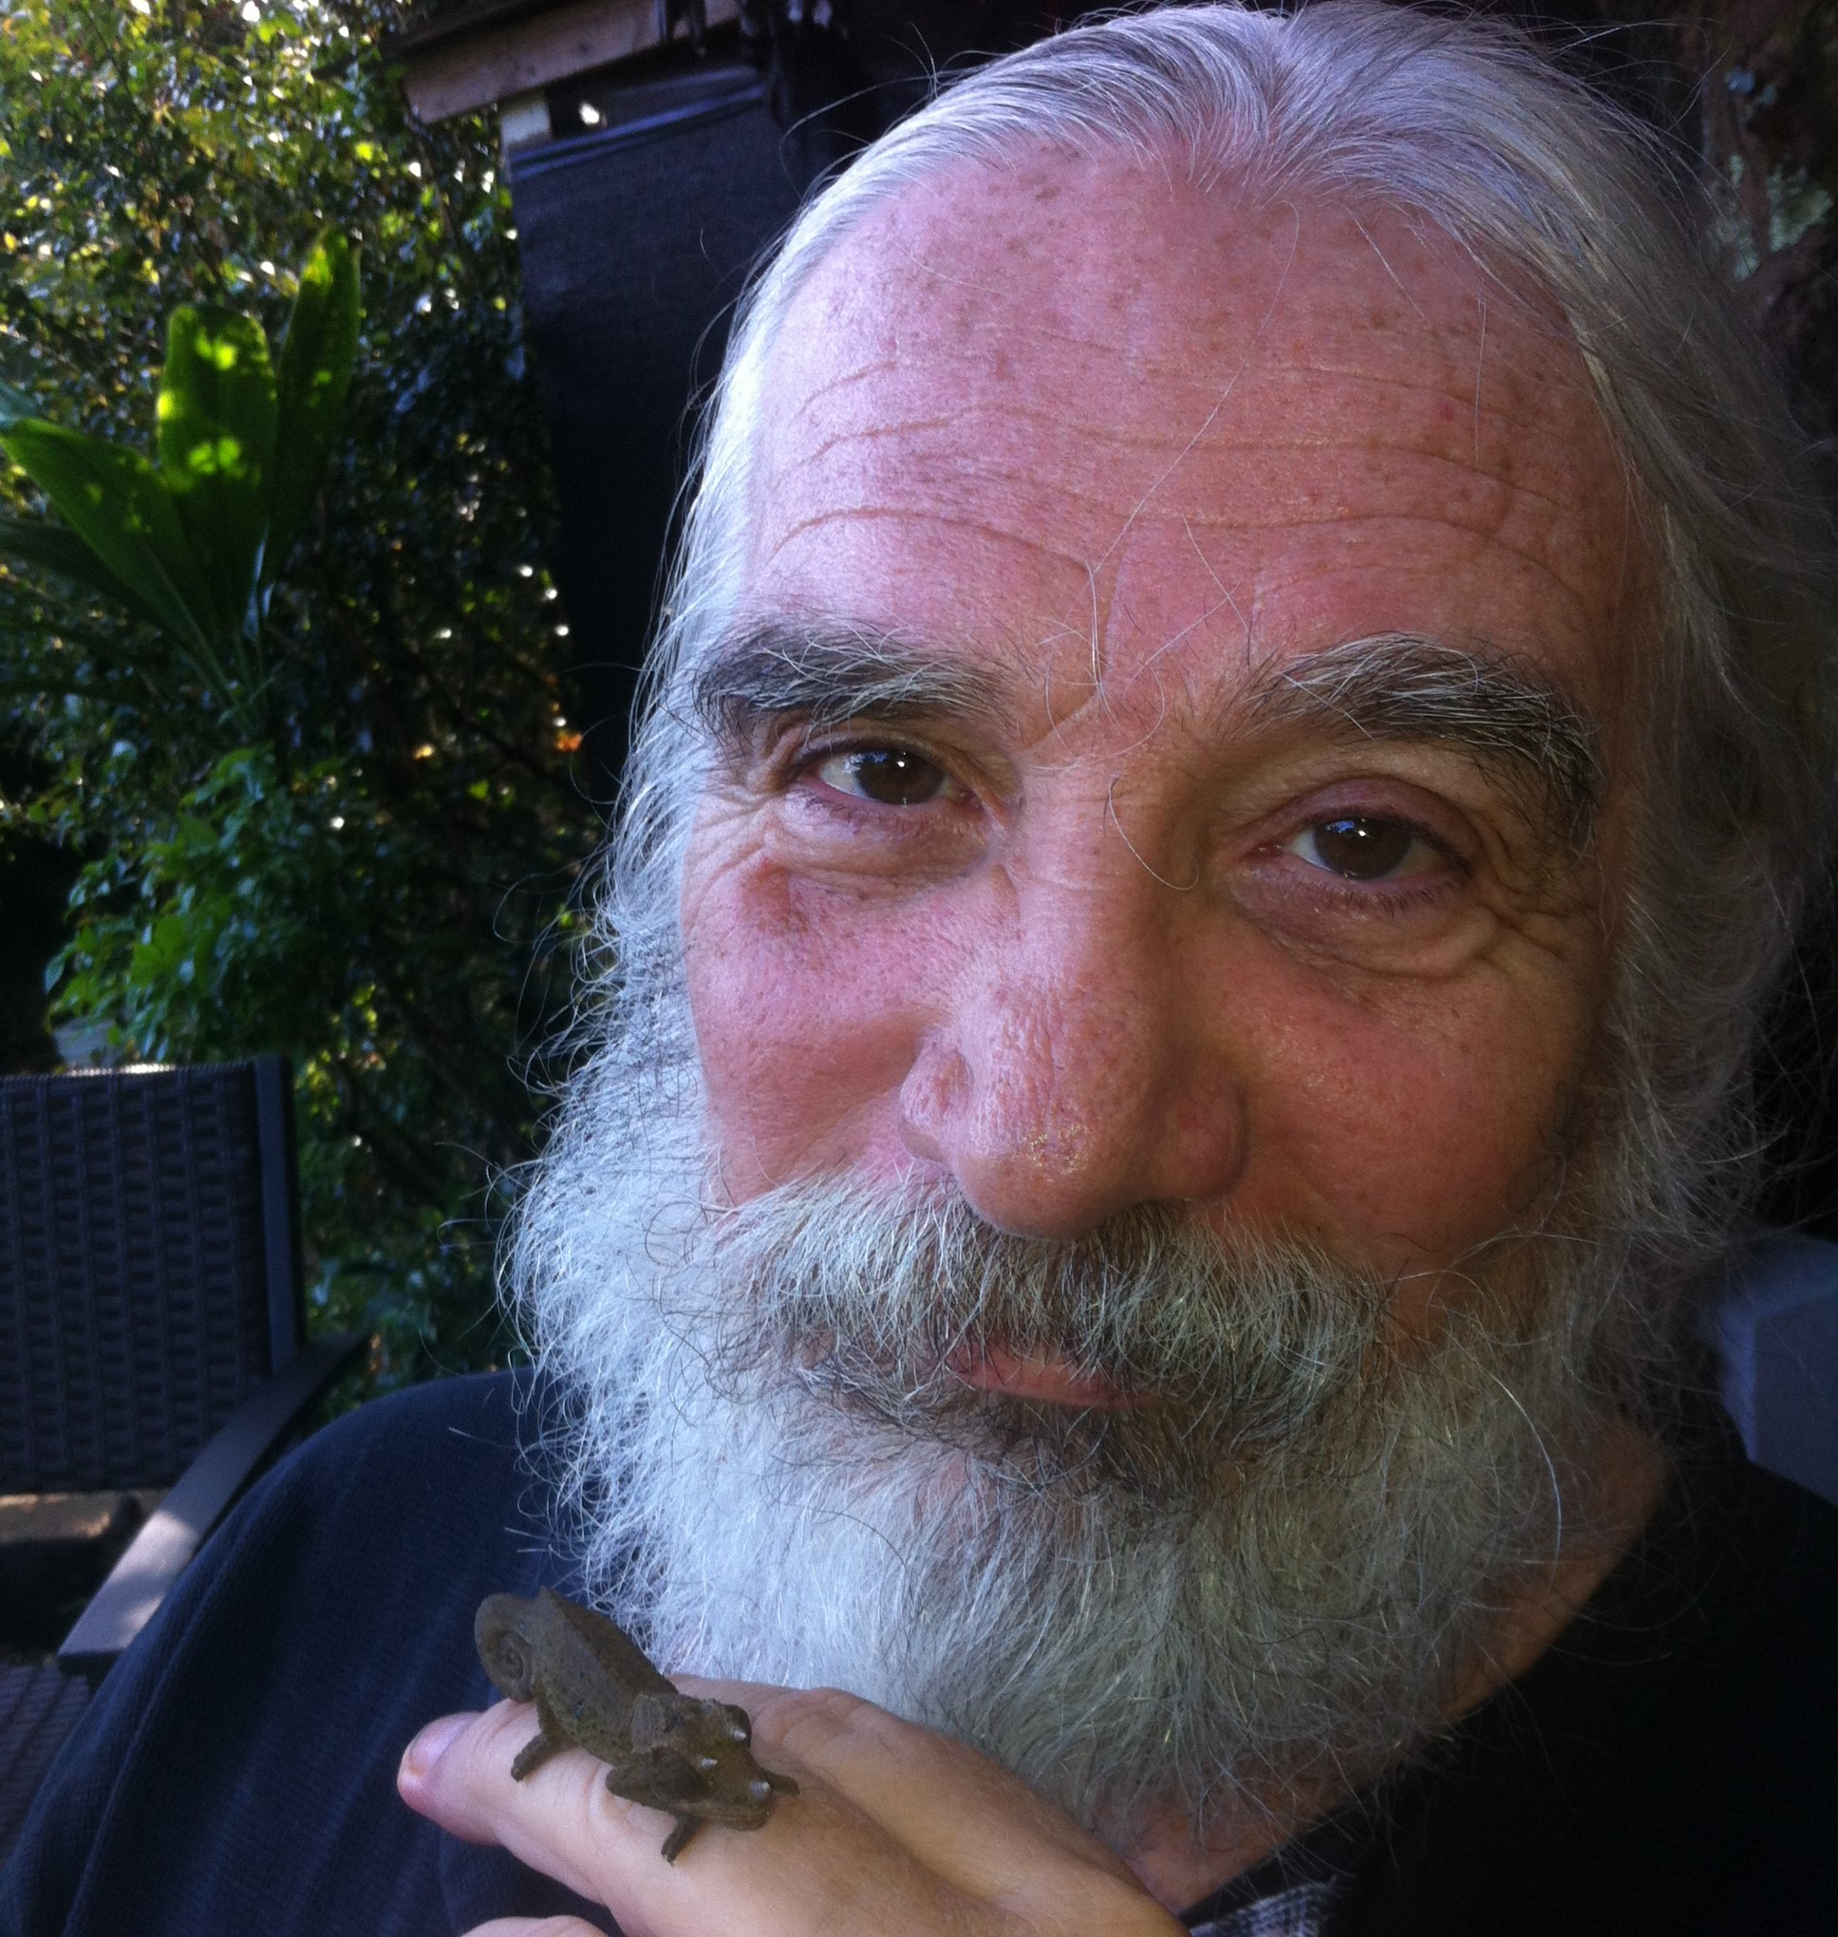
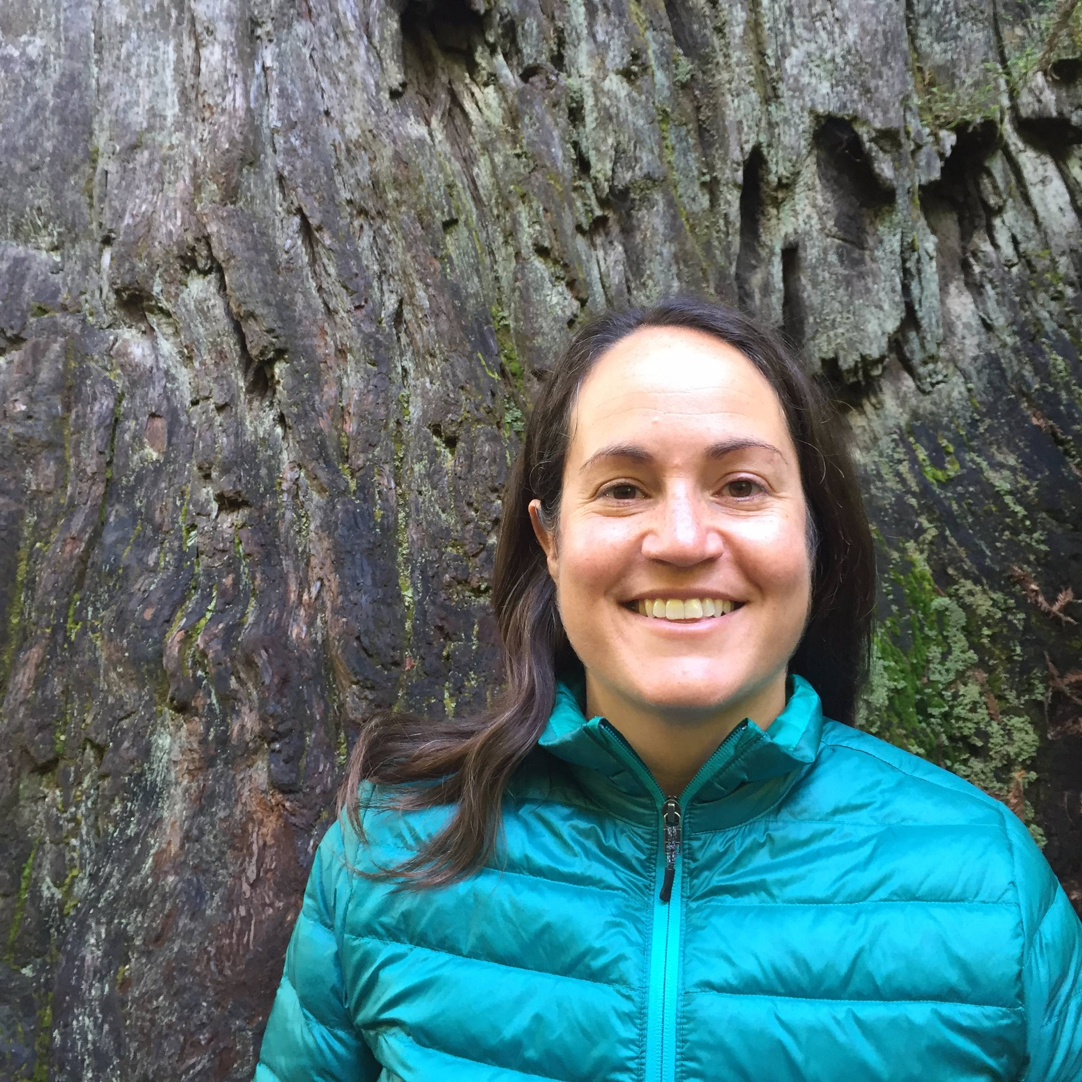
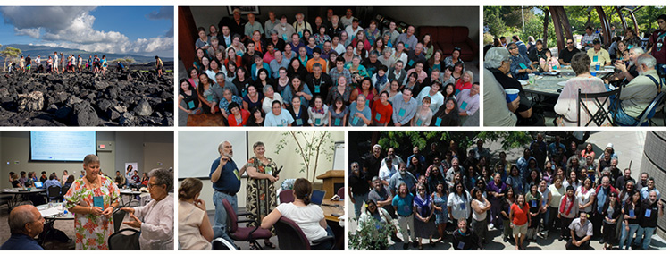
What Does This All Mean?
Pau nā mea pili pili - Relationships Matter
Ka mana o kekahi' – The power of one
Ka mana o na hui – The power of partnerships

Slide 7
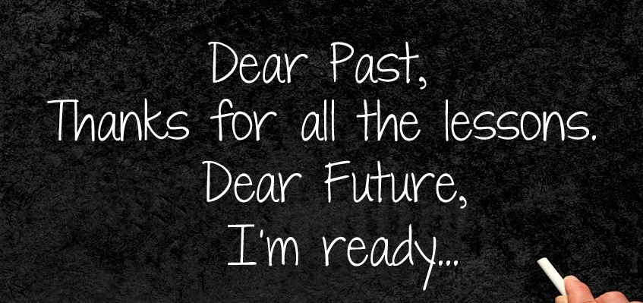

Slide 8
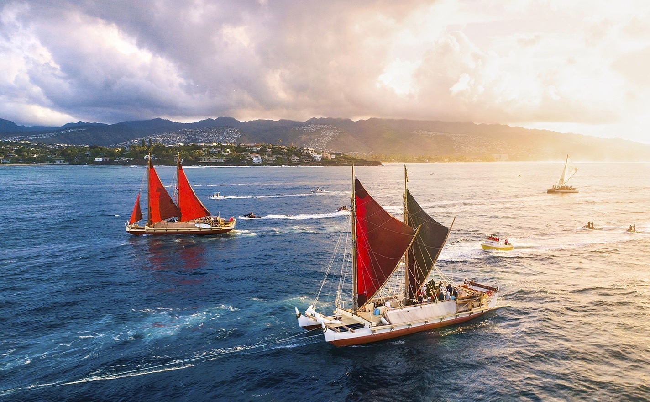
Mahalo Nui Kakou
Faafetai i tagata uma
Mihi koe katoa

