Slide 1
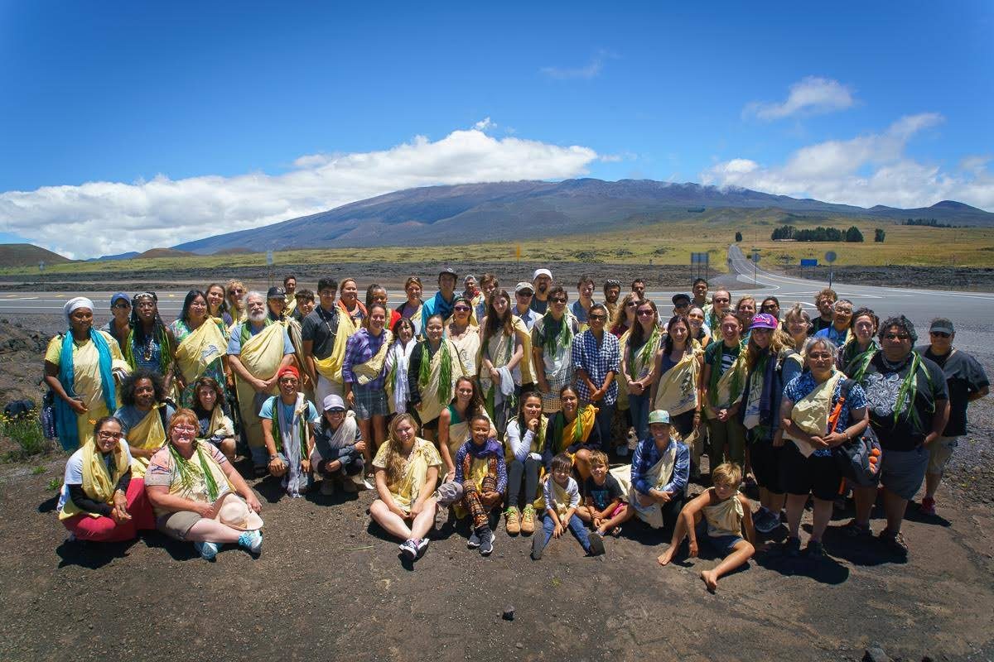
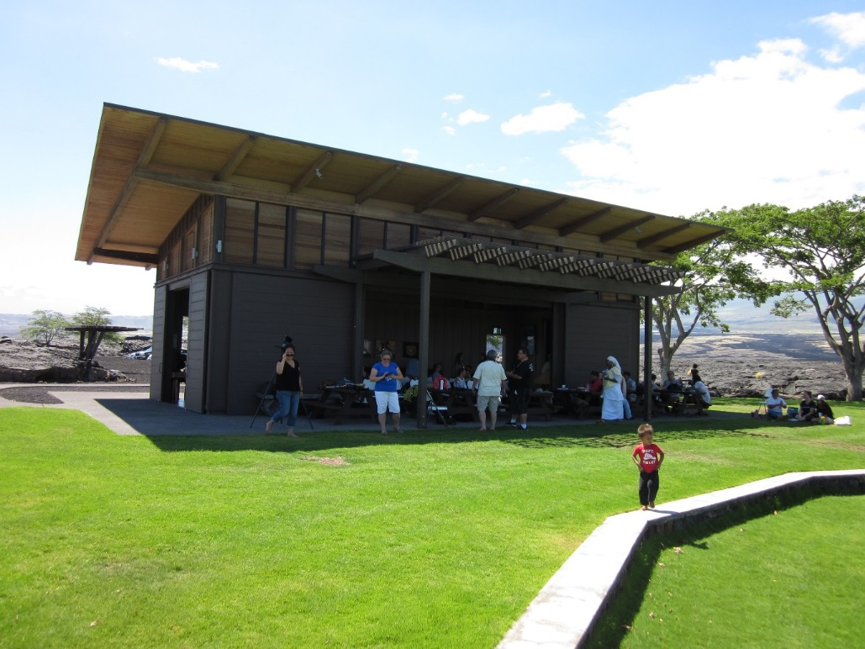
Rising Voices 4: Social Network Analysis
Building collaborations
Foster relational trust
Respectful knowledge sharing
Build climate adaptation capacity
Science to action

Slide 2
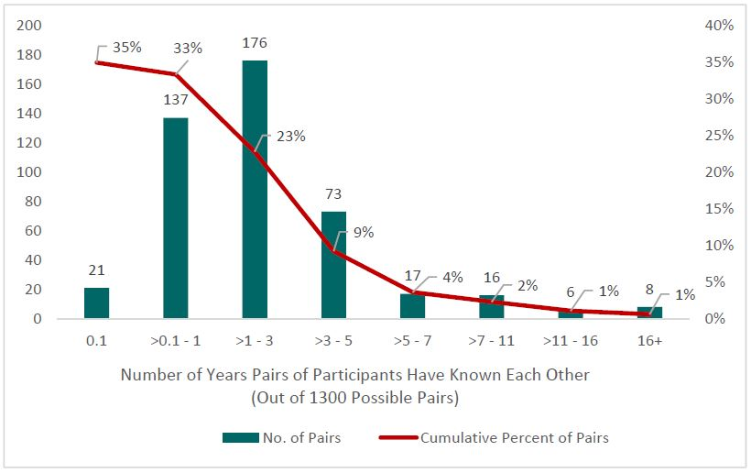
Rising Voices 4: How Long We’ve Known Each Other
35% of all possible pairs of people report knowing each other
23% > 1 year
9% > 3 years
4% > 5 years
Relational growth in past 1-5 years

Slide 3
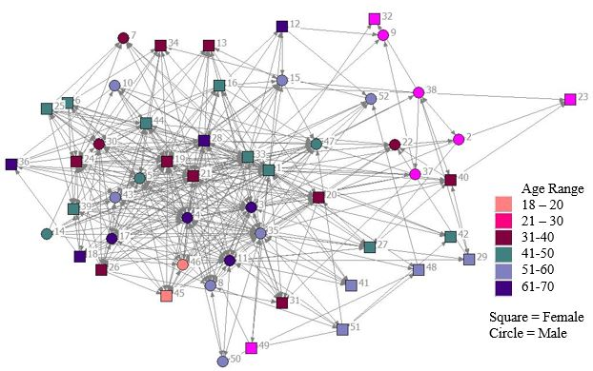
Rising Voices 4: Knowledge Sharing Network
21% of all possible connections
On average, we are sharing or receiving climate change knowledge with 11 other people

Slide 4
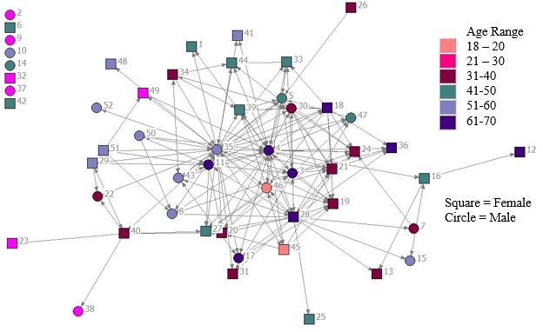
Rising Voices 4: Decision/Policy Network
8% of all possible connections
On average we are part of climate change decision or policy efforts with 4 other people
8 people with no connections

Slide 5
Rising Voices 5: Social Networks & Evaluation
RV5 this year: Survey asks similar questions about climate change collaborations with others who are here
Your name will not be listed with result summaries, but it is needed for social networks
Event evaluation on the last page & your responses will be disconnected from your survey
Please return survey after Friday’s last session or first thing Saturday morning
Your participation helps RV better understand and foster respectful and effective collaborations as part of Science to Action
~ Thank you! ~

