Slide 1
Fourth National Climate Assessment
Tribal and Indigenous Communities (Working Title)
Presented by: Shannon McNeeley
Rising Voices 5
Boulder, CO
From: Rachael Novak (BIA) and Lesley Jantarasami (EPA), Federal Coordinating Lead Authors
4/13/2017
Notes:
3

Slide 2
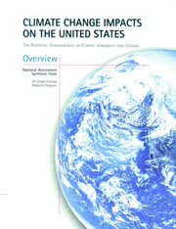
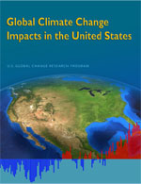
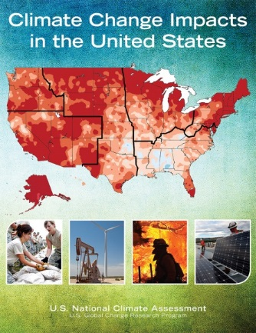
U.S. Global Change Research Program
USGCRP began as a Presidential Initiative in 1989
Mandated by Congress in the Global Change Research Act of 1990 (P.L. 101-606), “to assist the Nation and the world to understand, assess, predict, and respond to human-induced and natural processes of global change”
NCA1
NCA2
NCA3

Slide 3
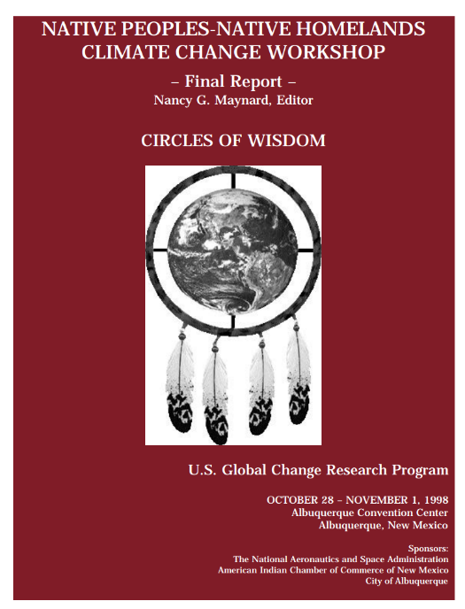
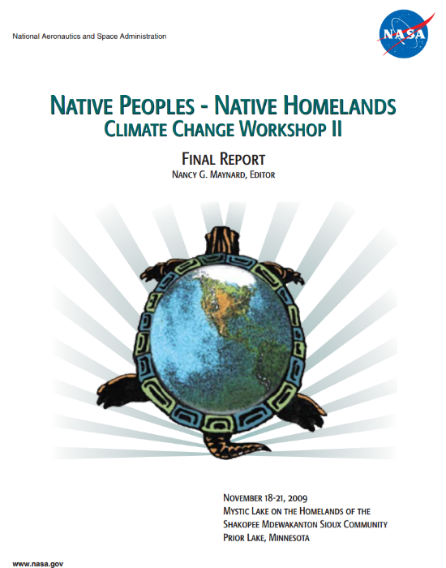
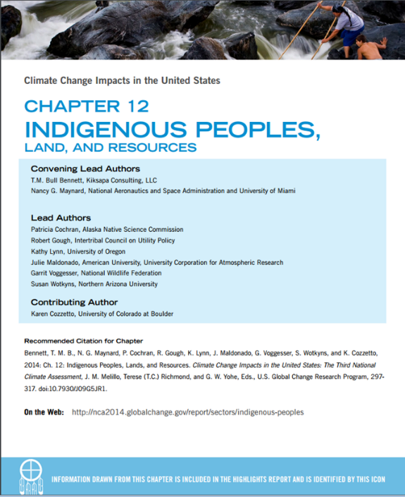
National Climate Assessment/ USGCRP Products prior to NCA4 (indigenous peoples related)
To download PDFs of these documents, please go to:
https://downloads.globalchange.gov/nca/nca1/native.pdf
http://neptune.gsfc.nasa.gov/csb/index.php?section=278
nca2014.globalchange.gov
health2016.globalchange.gov

Slide 4
Outreach Opportunities
Public Request for Information, summer 2016
Mini-grants for community meetings, fall 2016
Regional Engagement Workshops, winter 2017 (travel support, 28 scholarships)
Meeting outreach (Rising Voices 2016, AIHEC March 2016, NAFWS, and many others, SKC, CMN)
Input from non-peer reviewed sources will be considered through using a set of guidelines

Slide 5
NCA4 Chapters
I: Overview
II: Our Changing Climate
III: National Overviews
Water
Energy
Land Cover and Land Use Change
Forests
Ecosystems, Ecosystem Services, and Biodiversity
Coastal Effects
Oceans and Marine Resources
Agriculture and Rural Communities
Built Environment, Urban Systems, and Cities
Transportation
Air Quality NEW!
Human Health
Tribal and Indigenous Communities
Climate Effects on U.S. International Interests NEW!
Sectoral Interdependencies & Compounding Stressors: The Science of Complex Systems NEW!
IV: Regional Chapters
Northeast
Southeast
US Caribbean NEW!
Midwest
Northern Great Plains
Southern Great Plains
Northwest
Southwest
Alaska
Hawai`i and Pacific Islands
EXPANDED!
V: Response
Near-term Adaptation Needs and Increased Resiliency
Mitigation: Avoiding and Reducing Long-term Risks

Slide 6
Draft Outline for Indigenous Chapter
Note: Limited to ~6 pages, so cannot cover every relevant topic or go as in depth as regional chapters. This chapter will be a high level summary and synthesis of key topics new since NCA3.
State of the Sector
Build upon NCA3, use Climate Science Special Report as scientific foundation
Stressors and trends
What’s new since NCA3 and the Climate and Health Assessment
Regional Roll-ups (coordinating w/Regional Chapter Teams)
Anticipated Roll-up Topics:
Climate, culture, health
Water Resources
Economy and Livelihoods
Built Environment
Disaster Management
Relocation (or Expand!)

Slide 7
Draft Focal Areas / Key Messages
Key Message #1: Tribal Livelihoods & Economies are at Risk
KM #2: Tribal Culture, Health & Well-Being are at Risk
KM #3: There are challenges and opportunities along the path to sustainable, culturally appropriate tribal adaptation
e.g., subsistence, commercial, and household economies affected; infrastructure vulnerability
e.g., contamination (infectious disease), nutrition, access to traditional foods and medicine, mental health and social determinants, impact of relocation on culture and health
e.g., low adaptive capacity for many tribal/indigenous communities
e.g., long history as observers and monitors of the land and weather can inform adaptation strategies, social cohesion, etc.
Notes:
Much of our chapter’s content derives from the excellent synthesis done by Kathy Lynn and colleagues in a report finalized late last year that is available on the NCA site. These are also in part a synthesis of the anticipated Regional Roll-ups from the previous section of our chapter.
KM1: The first anticipated KM focuses on the risks to tribal livelihoods and economies from the full diversity of economy types from subsistence economies to commercial economic interests and from varying scales from the household scaled up to the tribal and beyond. These and the status of infrastructure can be considered existing conditions that can exacerbate or ameliorate climate change impacts.
KM2: The second focuses on the risk to Tribal Culture, Health & Well-being from contamination, nutrition, access to traditional foods and medicine, mental health and social determinants, and impacts of relocation on health and culture.
KM3: Finally, we want to focus on both the challenges and the opportunities in discussing the path to culturally appropriate adaptation for tribal communities. Tribes are diverse in the levels of capacity and this- as a sensitivity, interacts with climate type of climate risk/exposure to influence the type and significance of vulnerability level. However, on the flip side, there are opportunities, we don’t want to just focus on the issues associated with lower capacities, but the potential opportunities such as the long historical observations of land and weather that tribal communities may have that can inform adaptation strategies. Social cohesion may also be an adaptive capacity that can lessen the severity of vulnerability/impact on tribal communities.
One of the overwhelming pieces of input we’ve gotten time and time again from outreach discussions w/tribes over the last year + is that tribes don’t want to be treated simply as “populations of concern” or “vulnerable populations”. Federally recognized tribes have existing political relationship and status with the federal government and the federal government is responsible to approach tribes on a government to government basis, in acknowledgement of that relationship and responsibility to uphold past treaties and agreements. Other indigenous communities likely also identify as nations within nations and the message and content of all our chapters will be better received to acknowledge tribal communities separately from the “populations of concern” catch-all category so the good work of NCA teams can reach and help more tribal communities.
A similar piece of input received from tribal communities is to acknowledge the diversity across tribal nations. This could include the different types of economic bases, ecosystems, governance structures, infrastructure, and unique history. “If you know one tribe, you know one tribe.” Perhaps case studies could ensure broad applicability or focus on similar adaptative actions employed by many tribes in a region (e.g., many tribal adaptation plans/strategies).

Slide 8
Take-home Messages
Tribal issues will be integrated throughout NCA4
Observations, projections, impacts, and adaptation will be included in NCA4
Ways to engage with the Sustained NCA Process:
Session at the National Adaptation Forum (May 2017)
Fall 2017 (planned): NCA4 Public Review and Comment Period
globalchange.gov/notices
Will happen concurrently with a National Academies peer review
Calls for public input in future processes
Develop and/or provide input, studies, reports and other suggestions [?]
Sign up for NCA emails and tribal climate networks
globalchange.gov/newsletter-signup
Assist tribal climate efforts at the local scale → future case studies

Slide 9
Climate Science Center Tribal Liaisons

